Slide 1


Think Before You Click – Outsmarting Phishing Attacks
Kengatharan Piranavi

Slide 2

Welcome to the Phishing Awareness Training
This training will help you recognize and prevent phishing attacks to protect yourself and your organization.
“95% of cybersecurity breaches are caused by human error.” — IBM

Slide 3
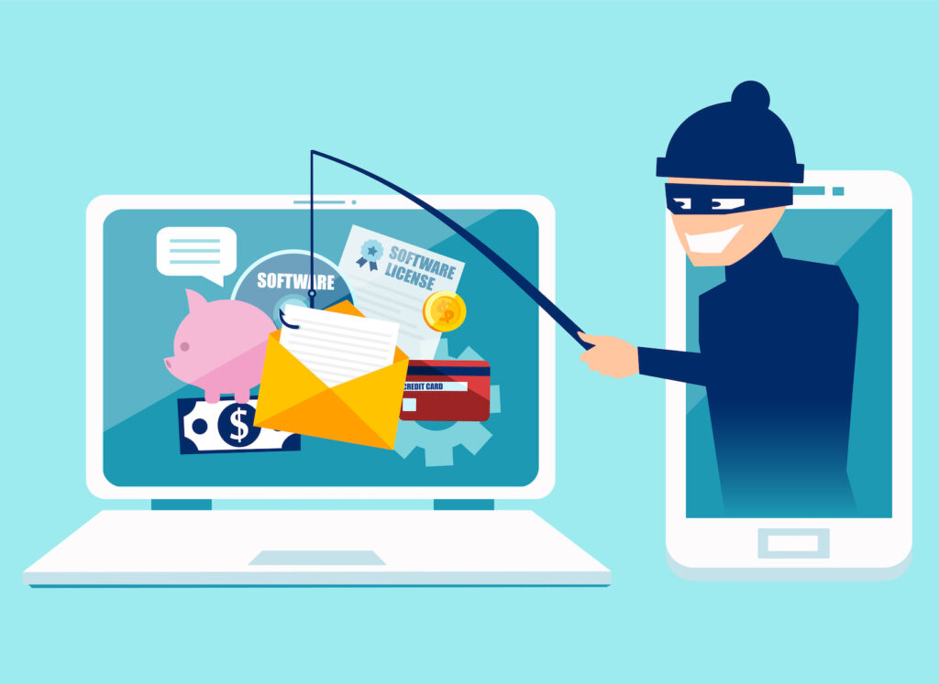
What is Phishing?
Phishing is a type of cyberattack where attackers trick users into revealing sensitive information by pretending to be legitimate contacts or services.
Common delivery methods:
Email (most common)
SMS (Smishing)Voice calls (Vishing)
Social media platforms
Example:
A fake email from “support@yourbank.co” asking to “verify your account immediately.”

Slide 4
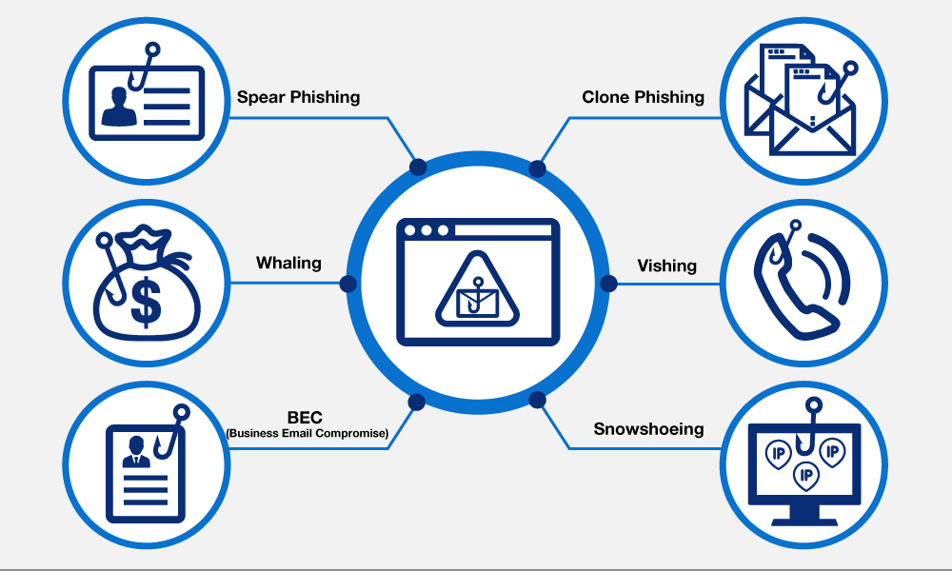
Types of Phishing Attacks
Email Phishing - Fake emails prompting clicks or downloads.
Spear Phishing - Targeted messages using personal info.
Whaling - Attacks on executives or leadership.
Smishing - Phishing through text messages.
Vishing - Voice calls pretending to be tech support.
Clone Phishing - Duplicates of legitimate emails with malicious links.

Slide 5

Anatomy of a Phishing Email
Red Flags to Watch For:
Mismatched sender address
Poor grammar or spelling
Suspicious attachments (.zip, .exe, .scr)
Urgent or threatening language (“Act now!”)
Fake links (hover to preview URL)

Slide 6
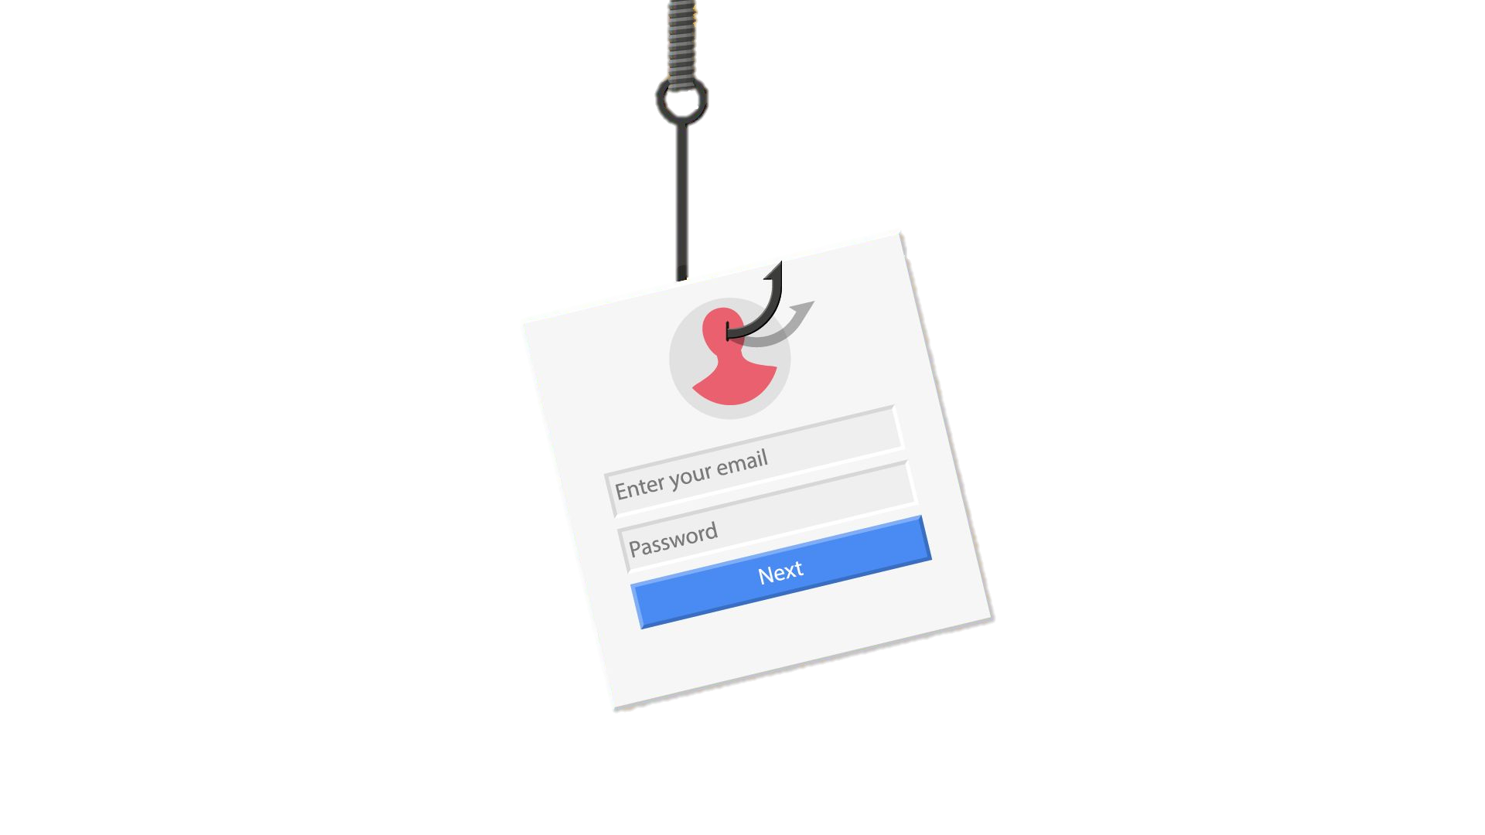
Phishing Websites
Attackers create fake websites that look legitimate to steal login credentials.
How to recognize them:
Look-alike domains: www.paypa1.com
HTTPS ≠ Safe (even phishing sites can have HTTPS)
Identical branding but fake forms

Slide 7
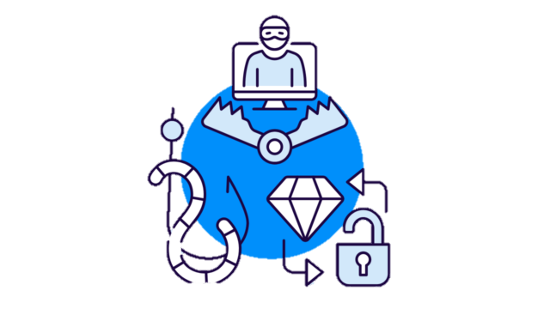
Social Engineering Tactics
Social engineering manipulates people into giving up confidential info.
Common tactics include:
Pretexting – Fake story to gain trust (e.g., “I’m from IT…”)
Baiting – Offering free downloads or rewards
Tailgating – Following someone into a secure area
Emotional Manipulation – Creating urgency, fear, or guilt

Slide 8
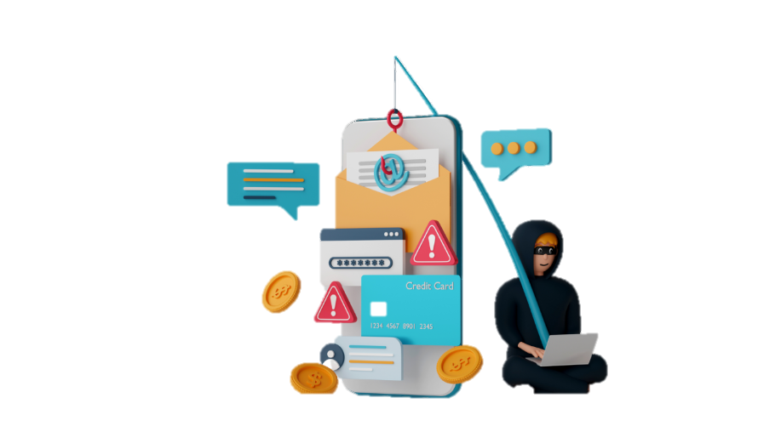
How to Spot and Avoid Phishing
Always verify the sender's email address
Don’t click on unexpected links or attachments
Hover over links to see the real URL
Use a password manager to detect spoofed domains
Report suspicious emails to your IT/Security team

Slide 9
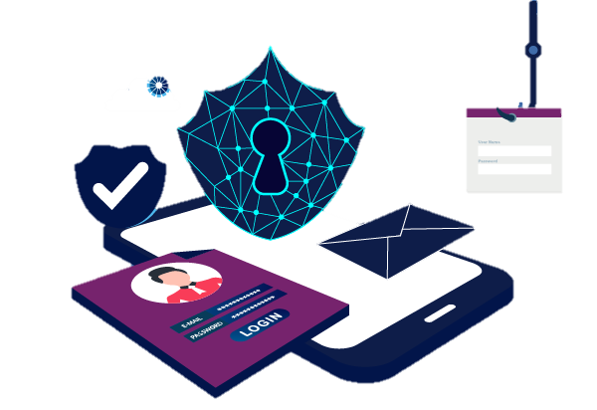
What To Do If You Suspect a Phishing Attempt
Don’t interact with the email or message
Report it to your IT/security team immediately
If clicked, disconnect from the internet
Change passwords (especially for affected accounts)
Run a malware scan on your device

Slide 10
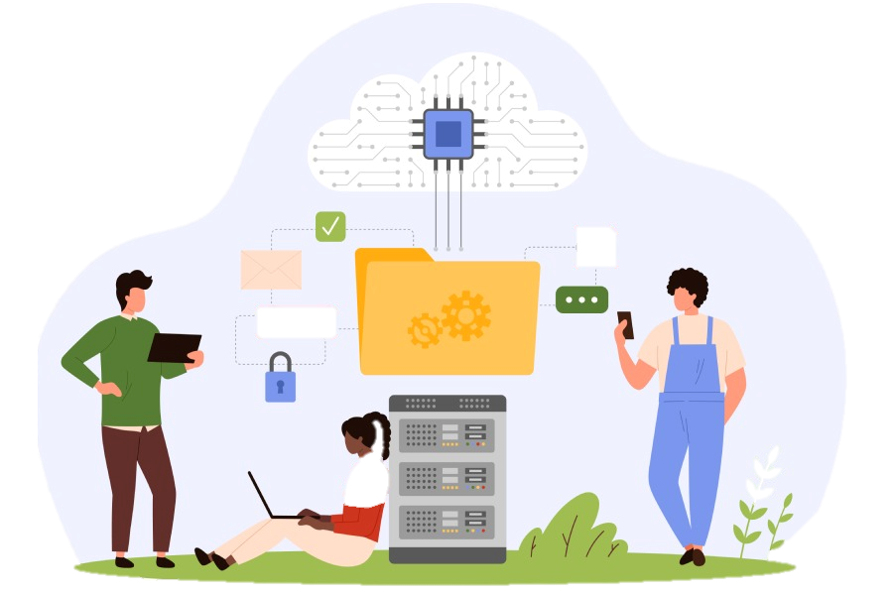
Tools and Protection
🛡️ Use these to protect yourself :
Spam filters and email scanning
Two-Factor Authentication (2FA)
Antivirus and endpoint protection
Keep operating systems and software updated
Attend cybersecurity awareness training regularly

Slide 11
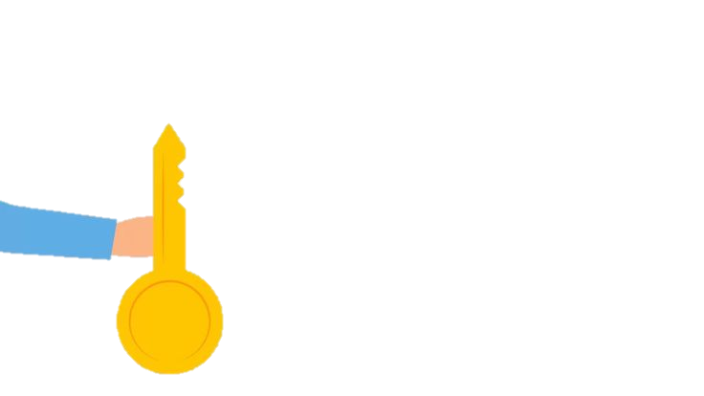
Conclusion & Key Takeaways
Always stay alert and cautious
Think before you click
Report suspicious activity—don’t assume someone else will
Use strong passwords and 2FA
Cybersecurity is everyone’s responsibility

Slide 12


